Slide 1
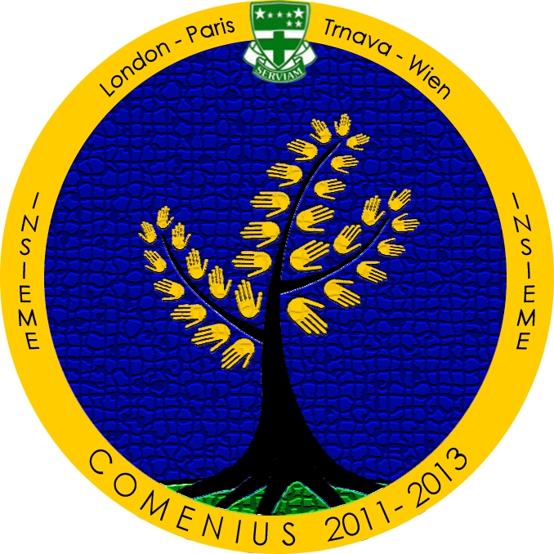
Trnava

Slide 2
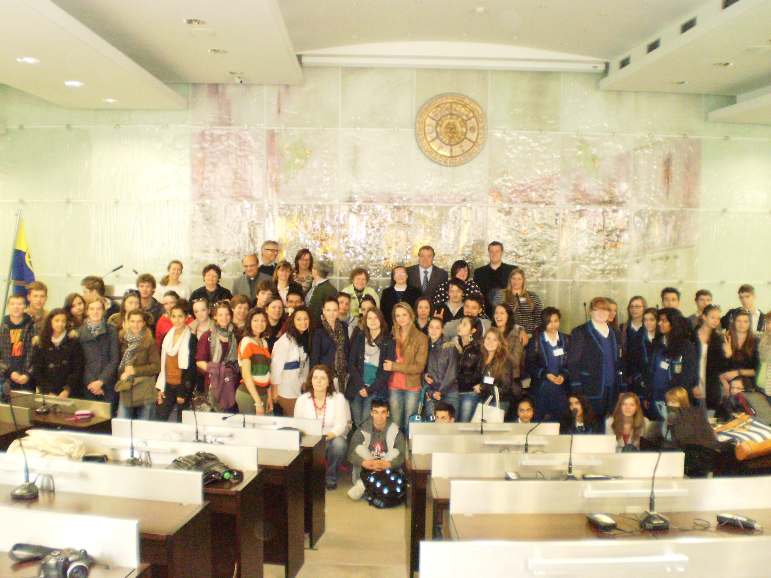
Day one

Slide 3
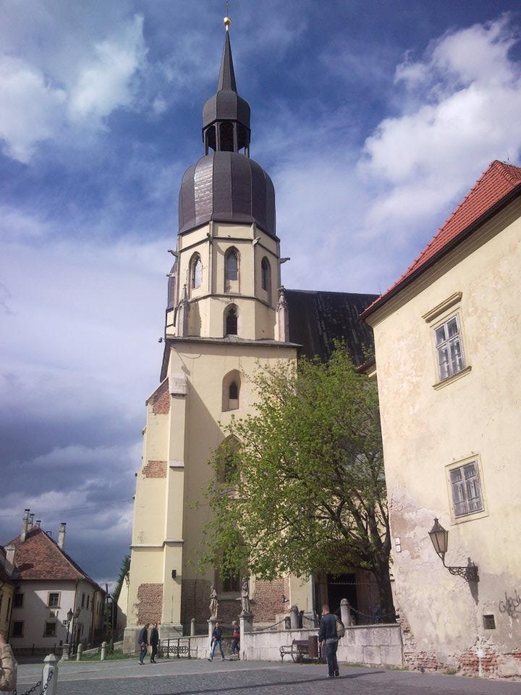
Finally here...
After an anticipated wait, we were finally given an opportunity to host Comenius in Slovakia.
The students flew in from our sister schools in Vienna, Paris and London on the 23rd of April, 2012.

Slide 4
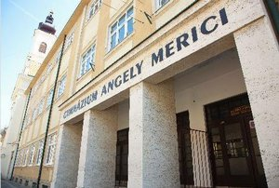
Day two

Slide 5
Welcoming
The students were sorted into their temporary foster families, with which they could enjoy their free time and discover a bit of Slovakia.
In the morning, they were welcomed with open arms at our school.
Our headmistress provided the introductions and our students provided the snacks.

Slide 6
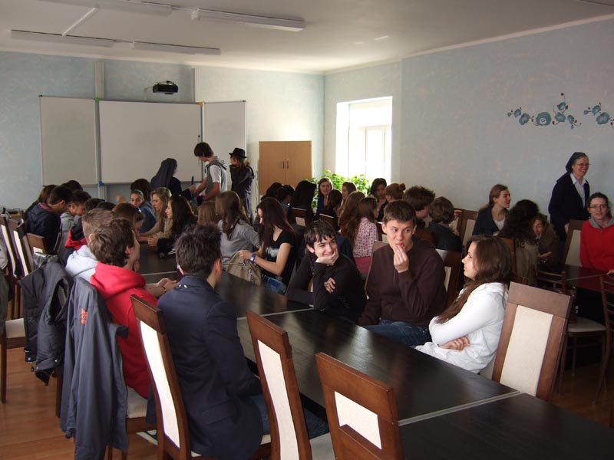
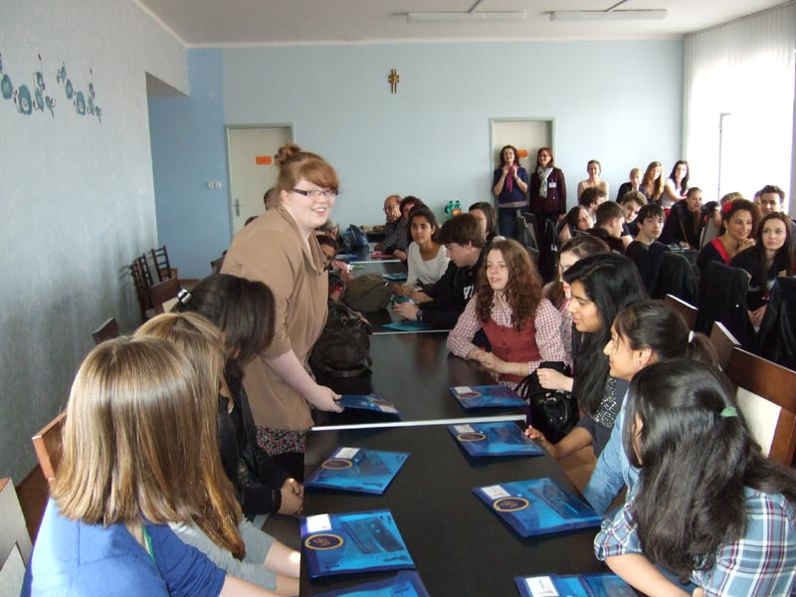
Icebreakers
With our bellies filled, it was time to get to know each other a little better, starting with the feared standard introductions.
Then we were left to go explore the school.

Slide 7
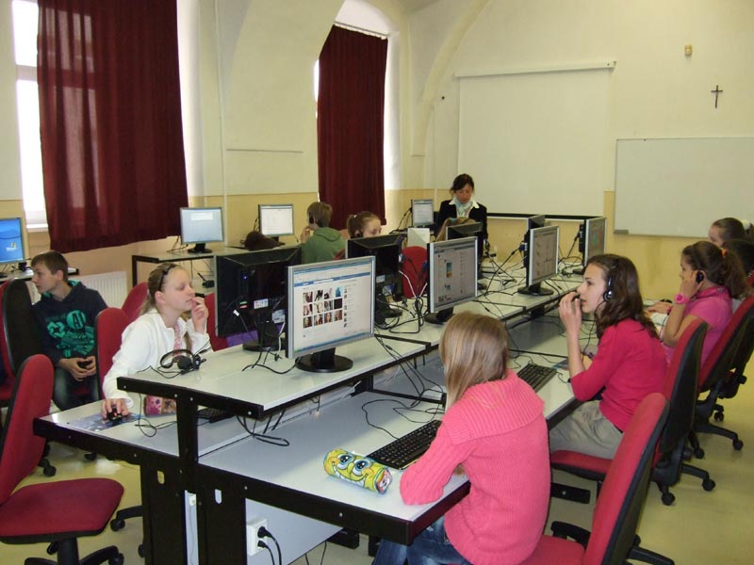
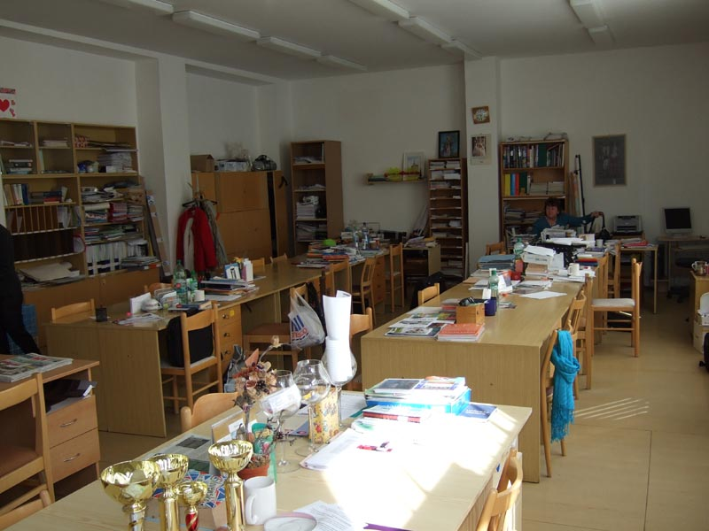
Attending lessons in GAM
After showing off each nook and cranny, we took our international friends into classrooms to attend some of our classes.

Slide 8
Kalokagatia workshops
In the afternoon, the students were sorted into groups and tried out 4 different activities:
Crafts - jewelry
Pottery
Dance
Target practice

Slide 9
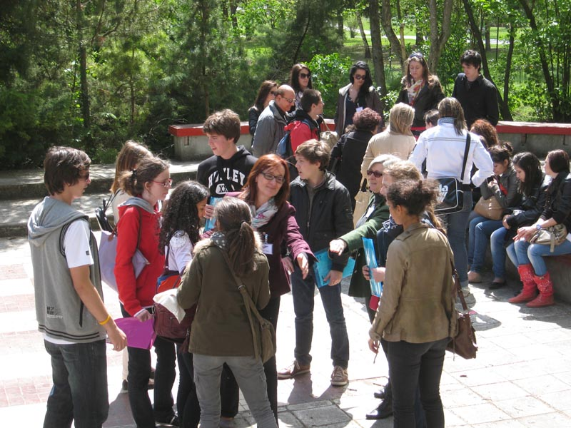

Slide 10
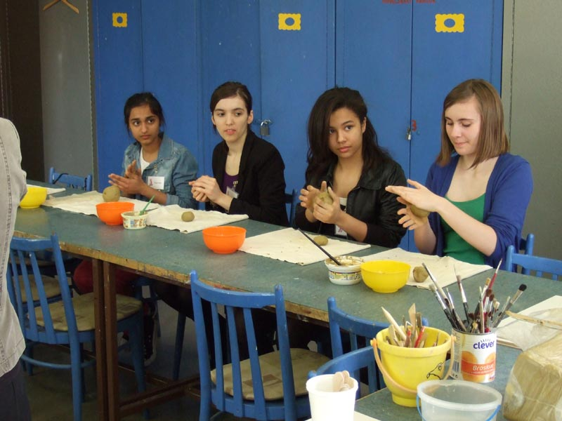

Slide 11
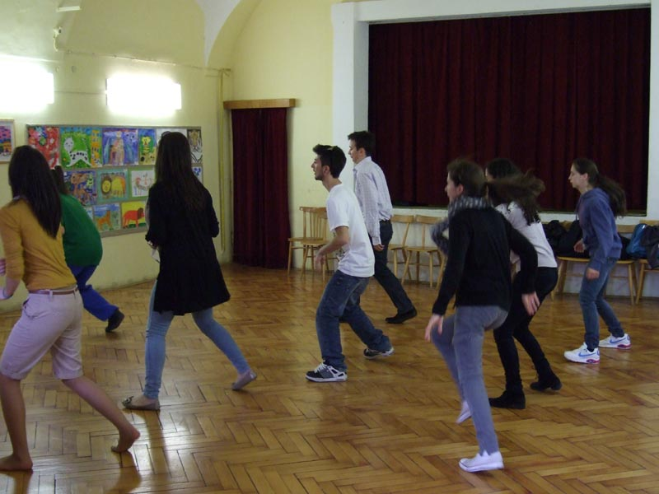

Slide 12
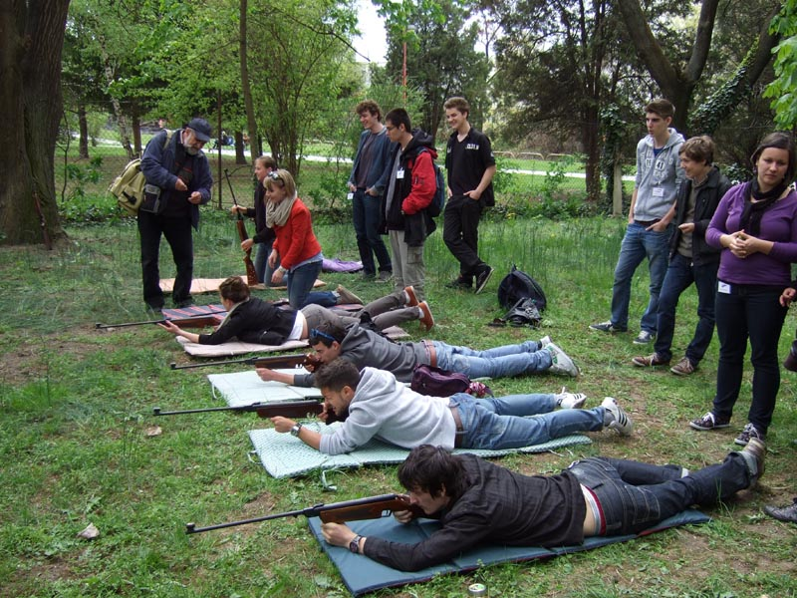

Slide 13
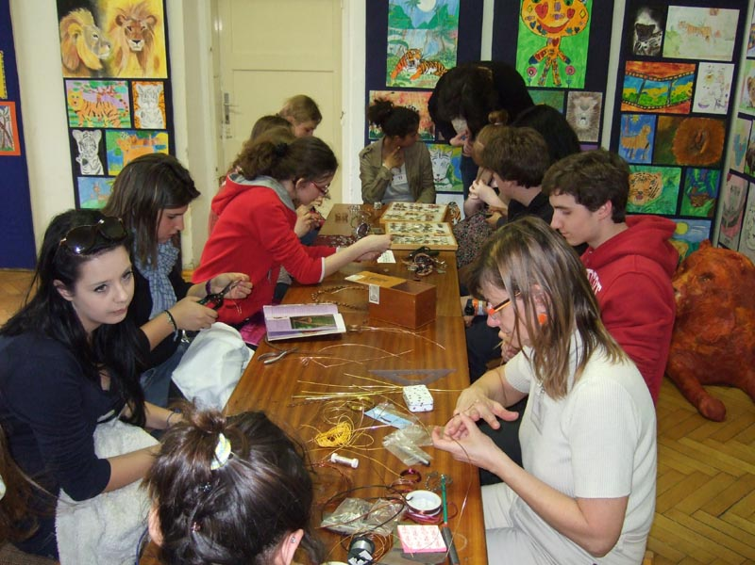

Slide 14
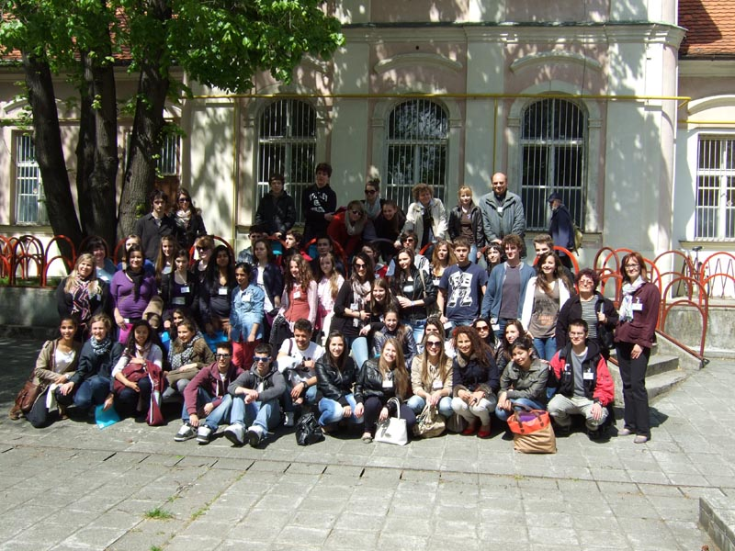

Slide 15
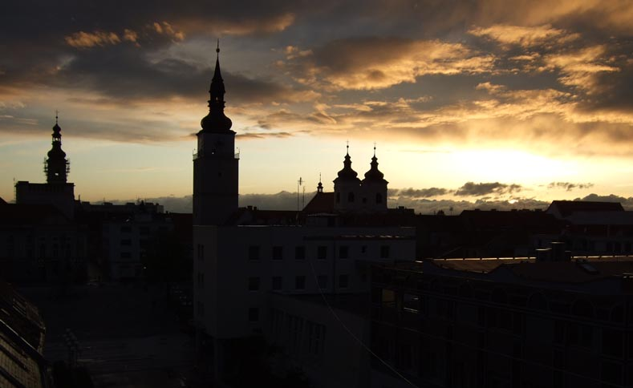

Slide 16
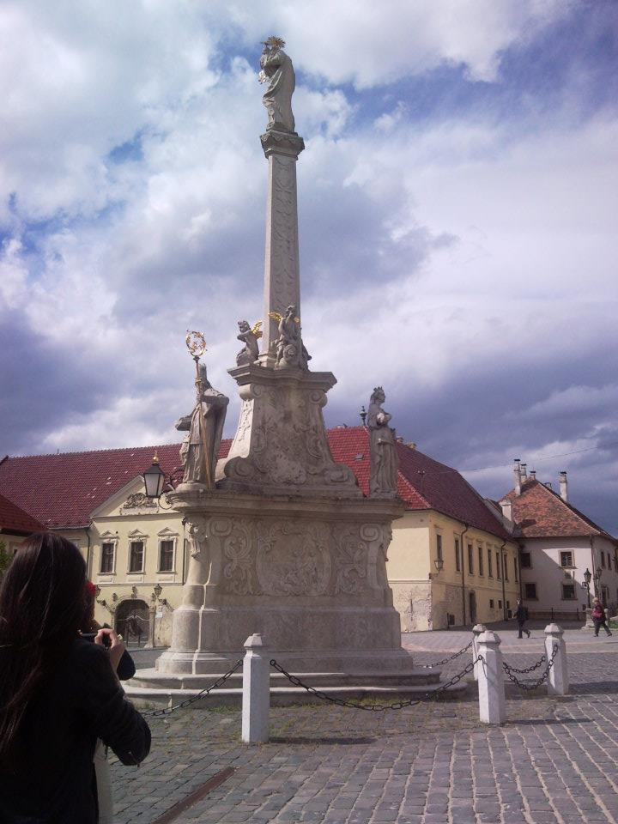
Exploring the city...
The students were told to find certain historically important monuments. They were given a map to help them along the way.

Slide 17
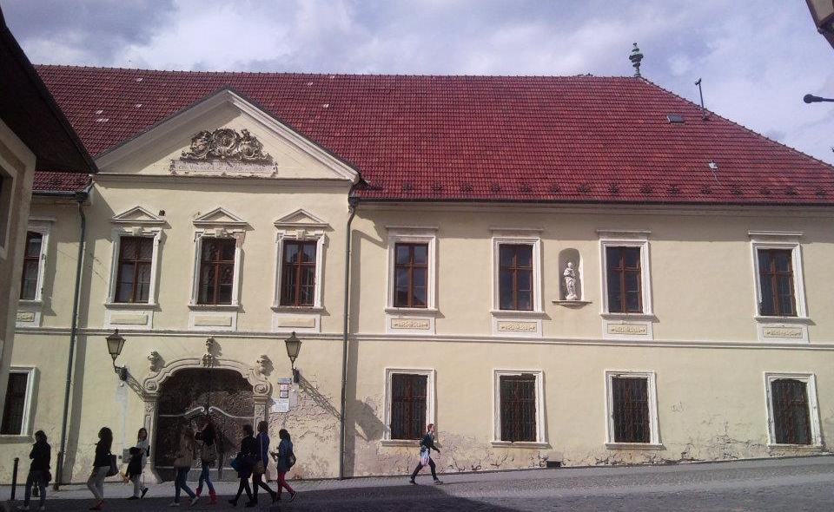
Where sense of navigation was lacking, Slovak students stepped in and helped.

Slide 18
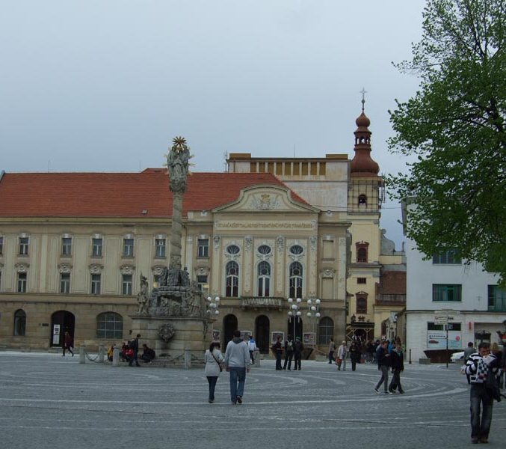
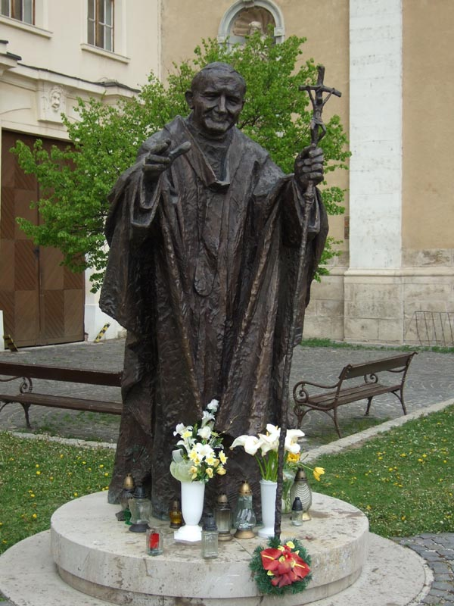
At each one of the stops, students learned new information about given monument.

Slide 19
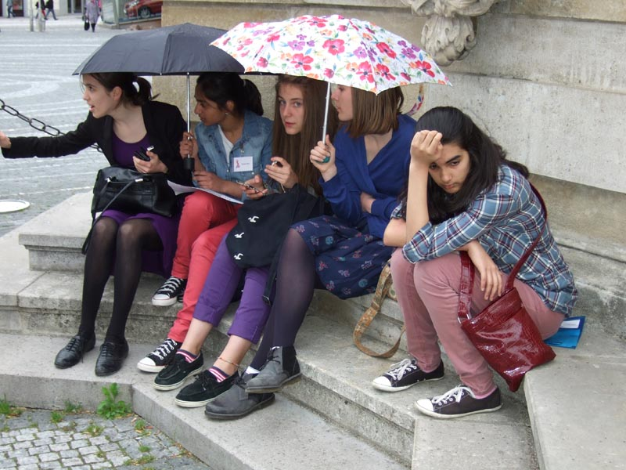
Even the spring rain caught up with us ☺

Slide 20
Day three

Slide 21
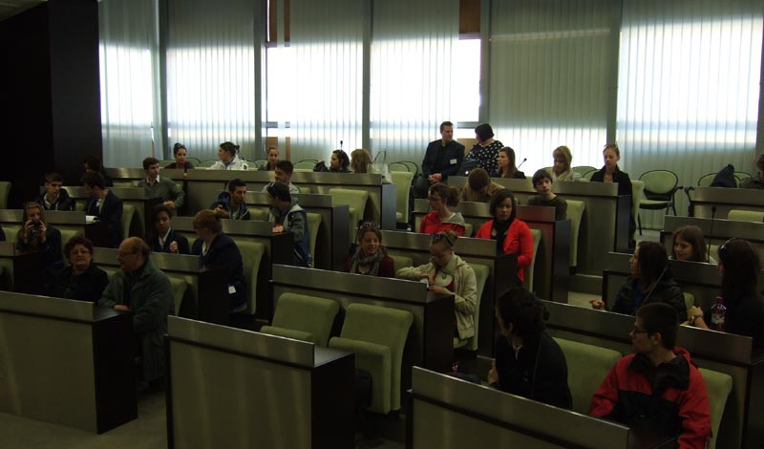
The day started off in the main hall of he local government

Slide 22
Kalokagatia workshops
The day started off in the main hall of the seat of Trnava’s Local Government
Here, the mayor of Trnava gave a speech, which was interpreted into English on the spot.
He then answered our questions.

Slide 24
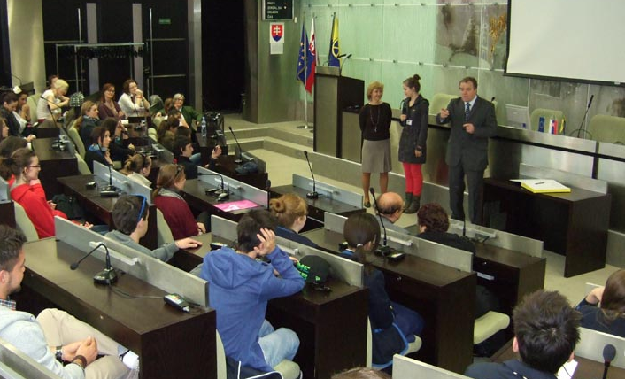

Slide 25
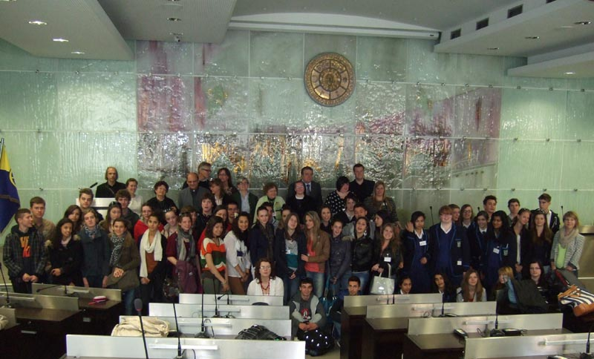
…and a photograph for the road

Slide 26
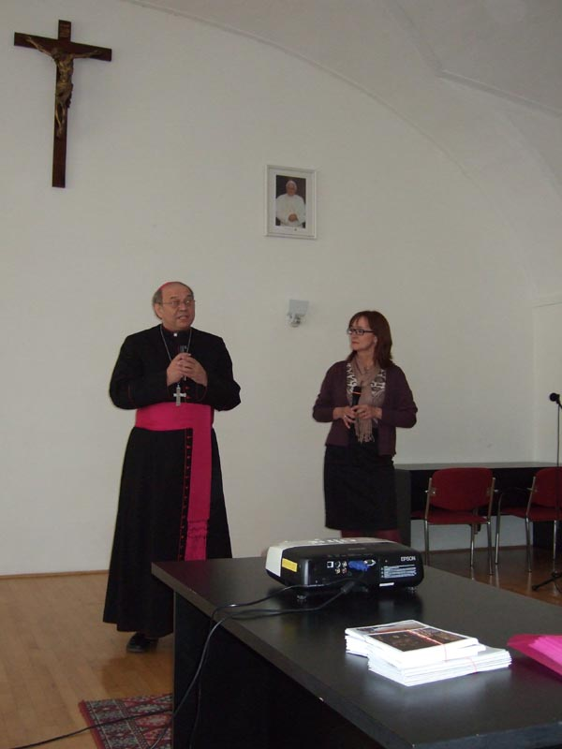
Seat of Arcibishop
We were greeted by Monsignor Orosz and then the presentations from each school started.
The topic for discussion was: “The young and their world”

Slide 27
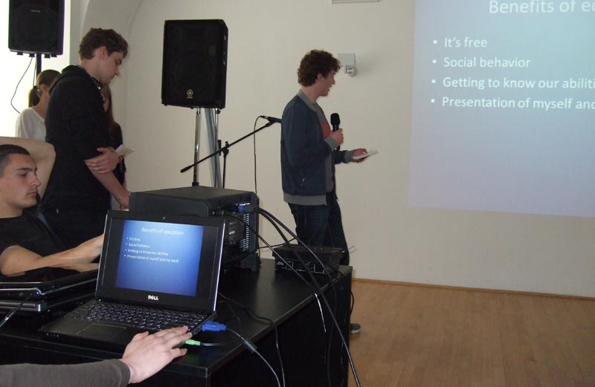
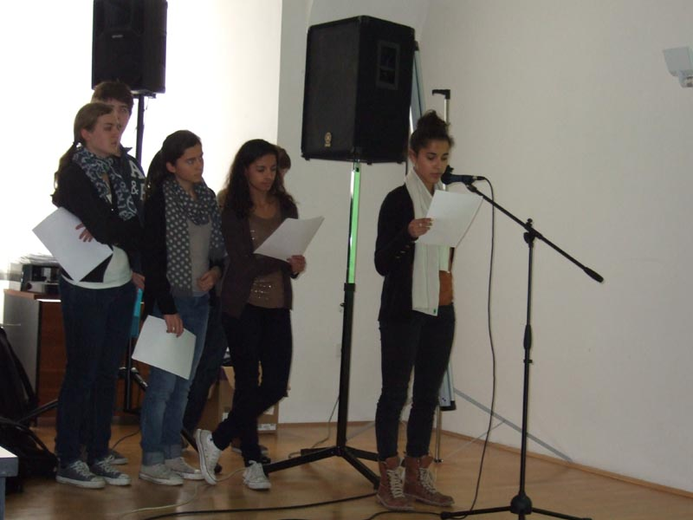
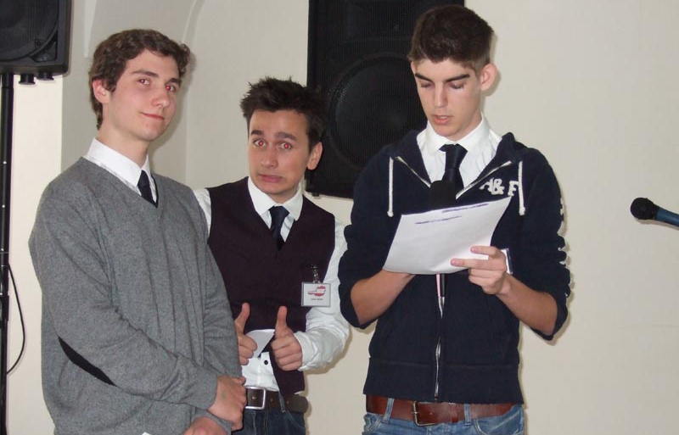
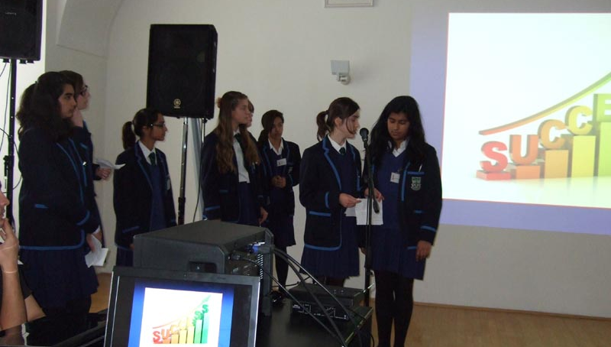

Slide 28
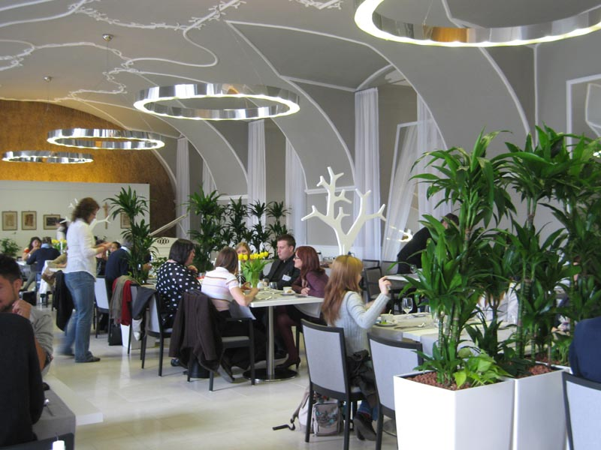
Sharing a meal
We had a filling lunch at the Gallery Restaurant.

Slide 29
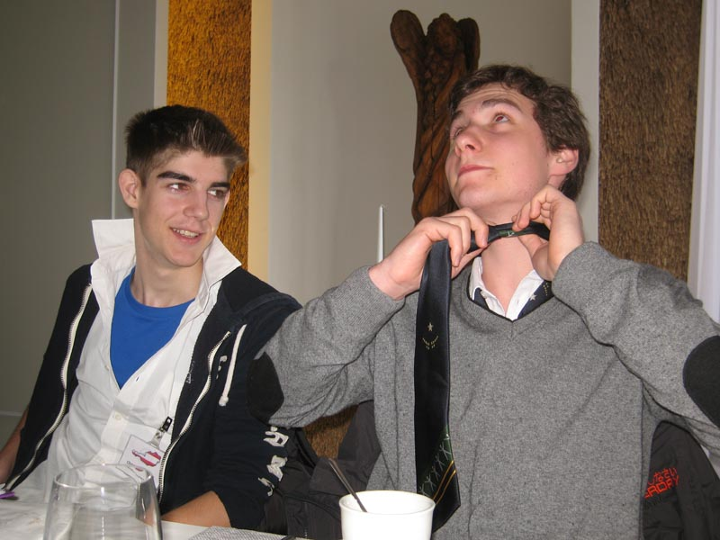

Slide 30
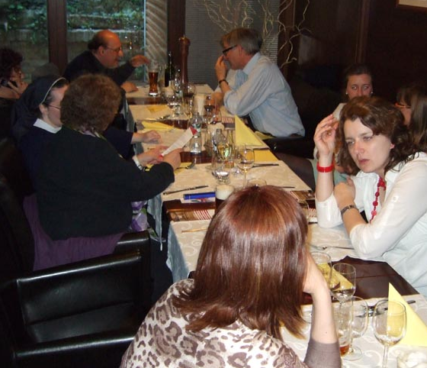

Slide 31
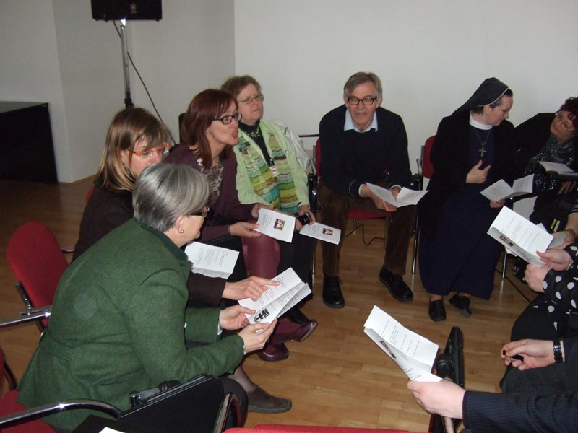
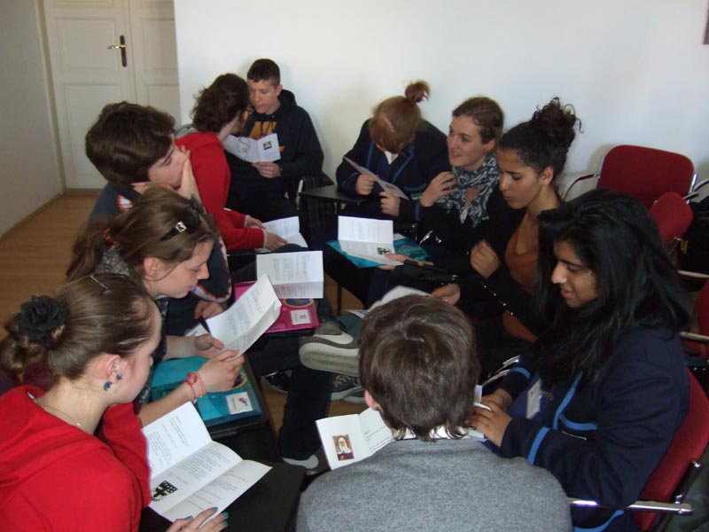
International Group Discussions
We talked about st. Angela – the patron of our school. We discussed her life, her mission, her thoughts…

Slide 32
Day four

Slide 33
Mass in St. Anna´s Church
The day started off with a communal mass, served in 4 languages, so we all understood.
After mass, we went to Bratislava – the capital of Slovakia.
We took a tour of the city on a train, called the “Prešporáčik”.
After that, we said our goodbyes, exchanged emails and were left with the satisfying feeling of pulling off a great success

Slide 34
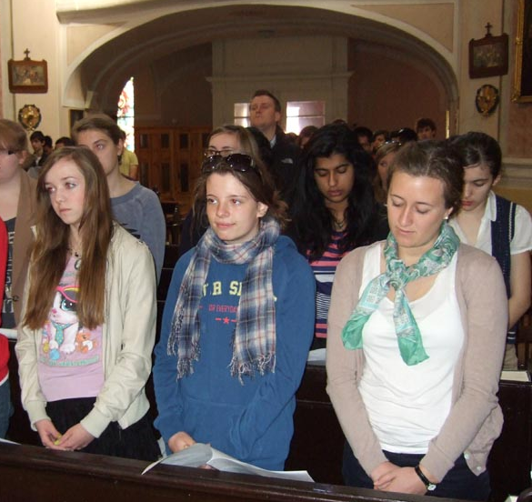

Slide 35
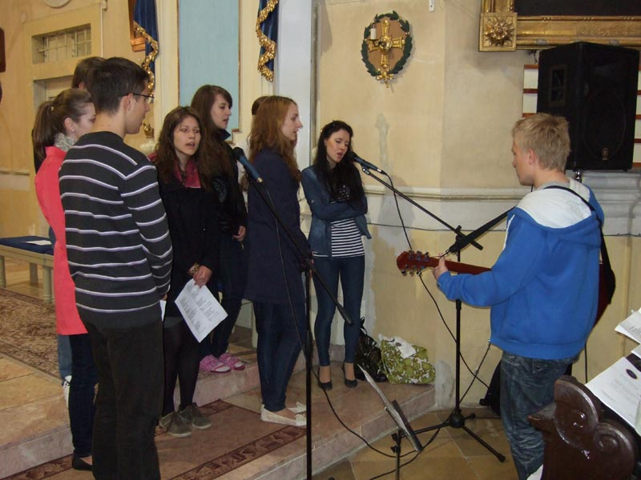
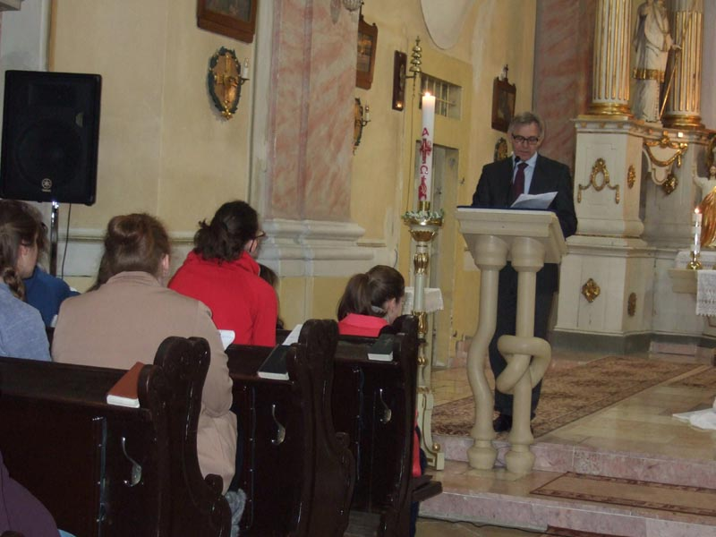
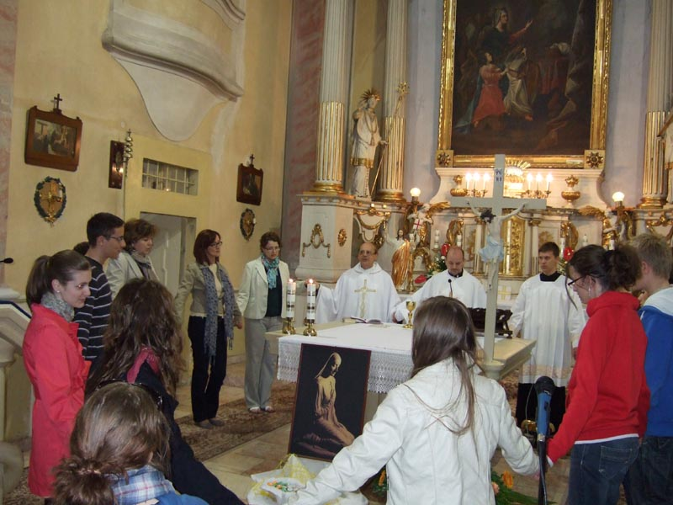
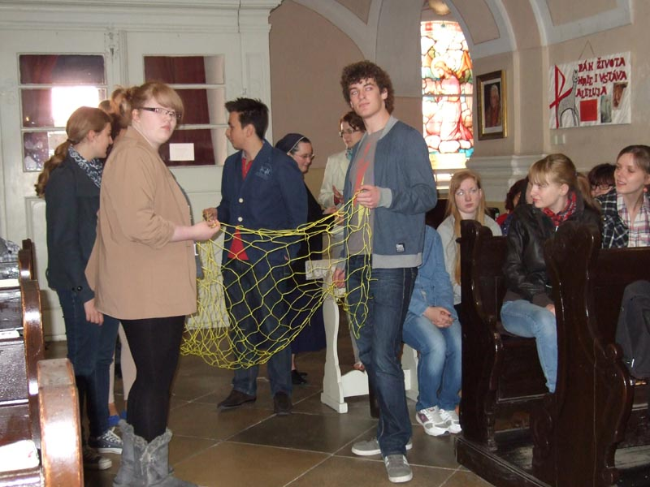

Slide 36
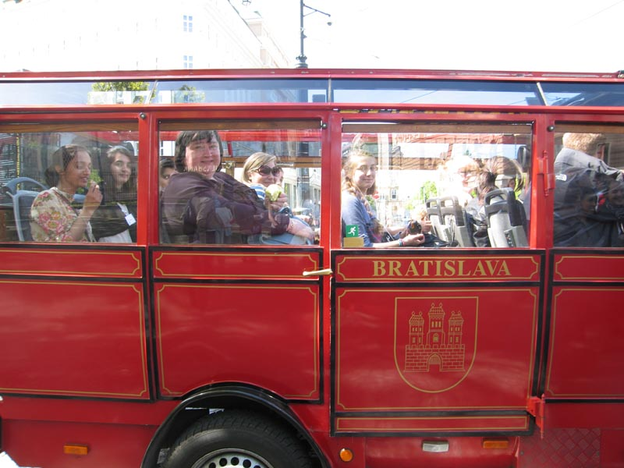
Bratislava – the Capital

Slide 37
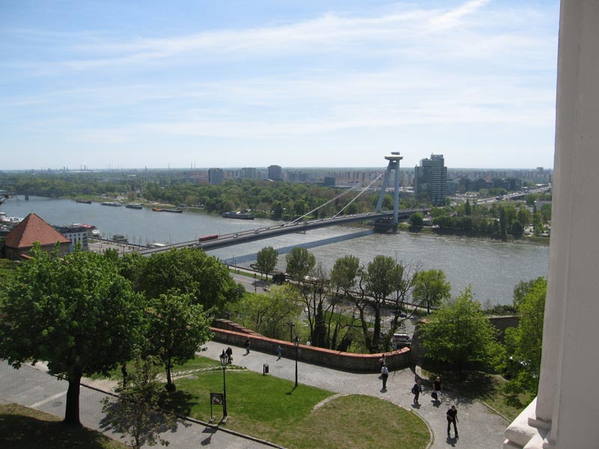

Slide 38
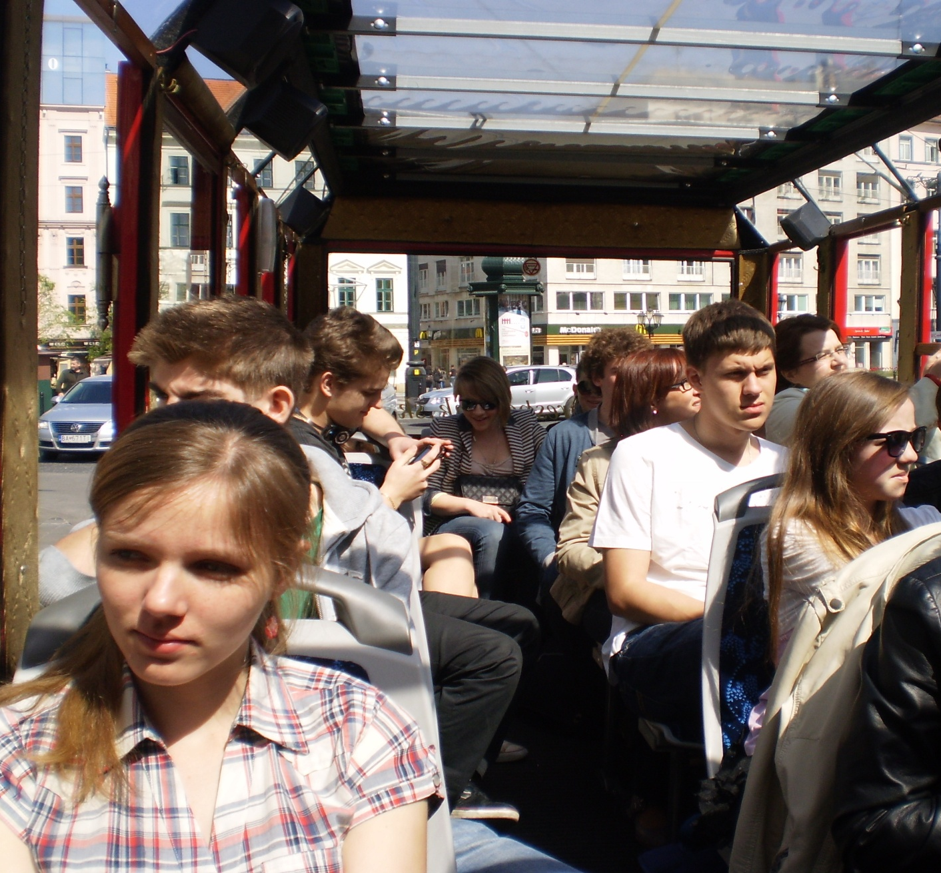

Slide 39
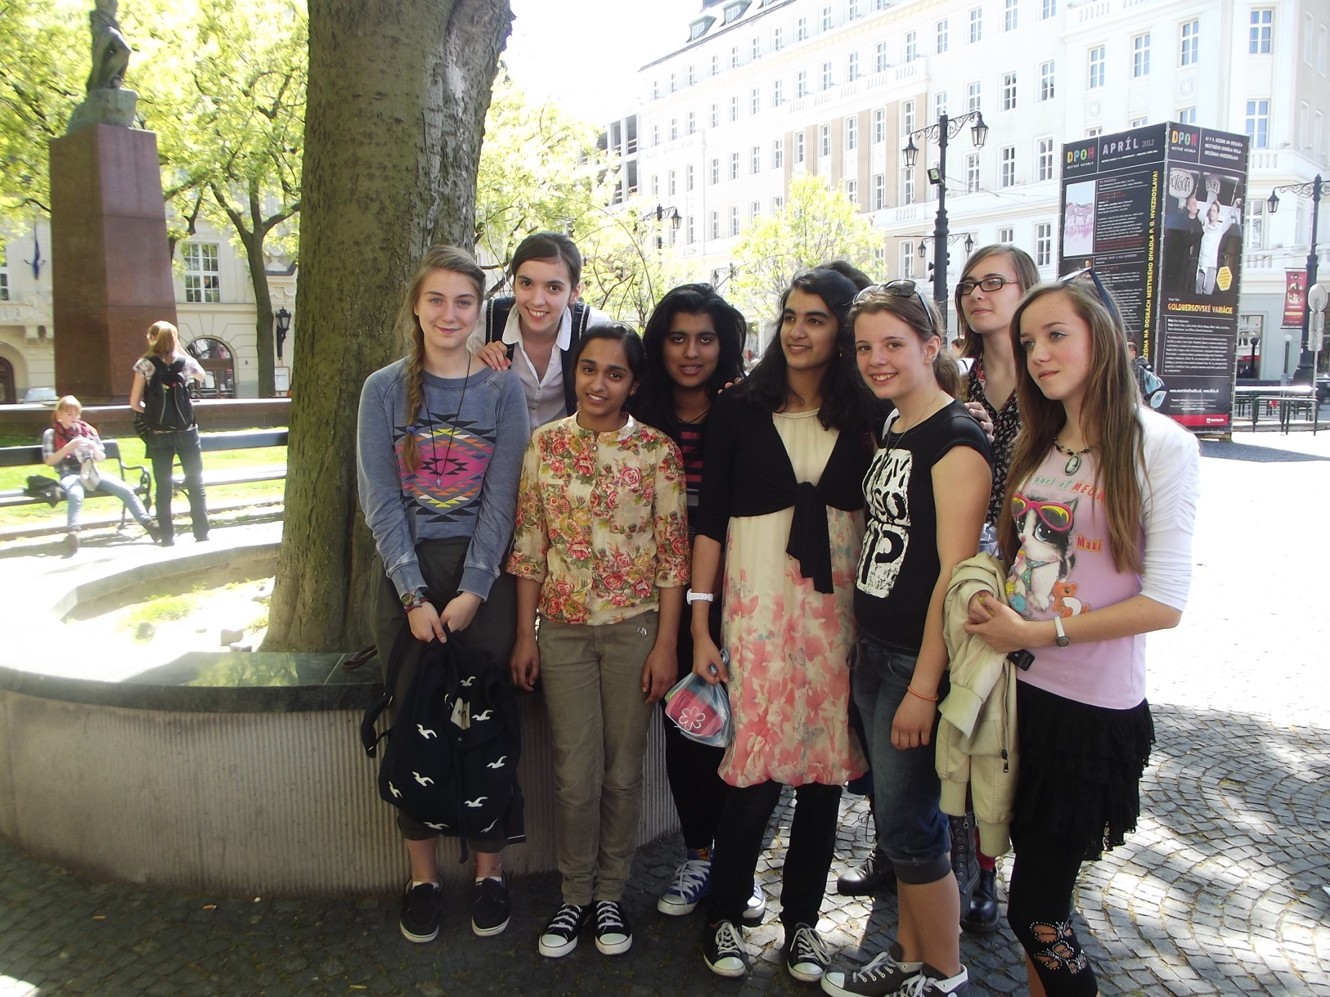

Slide 40
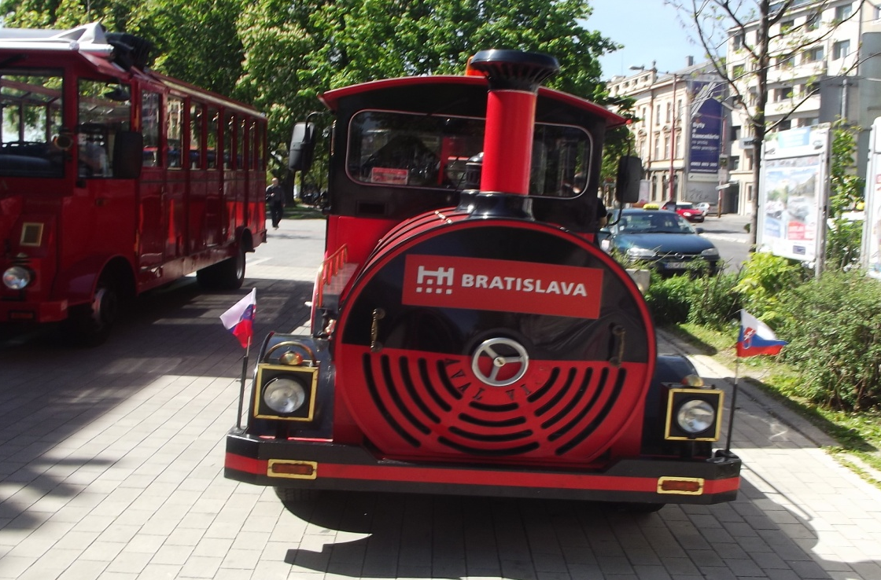

Slide 41
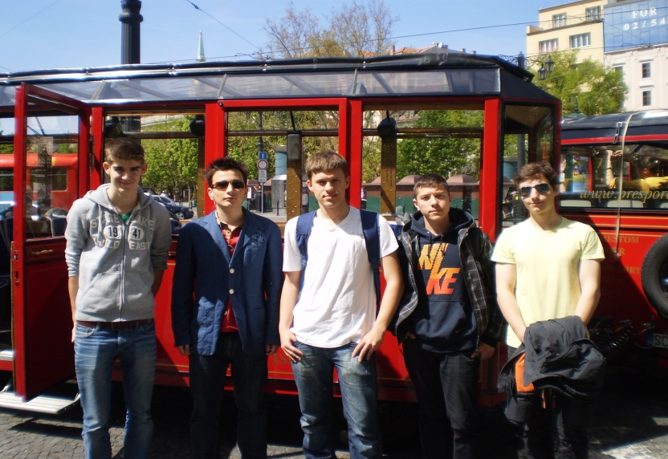

Slide 42
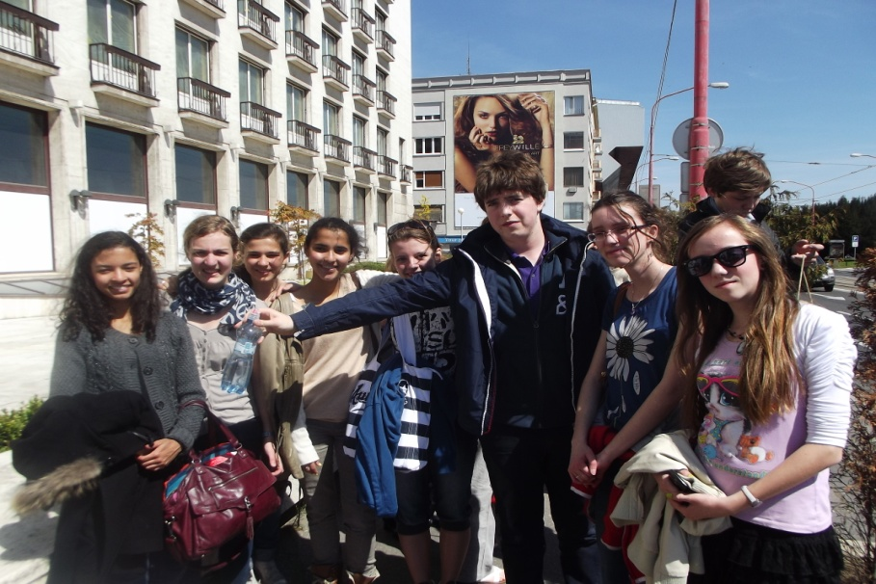

Slide 44
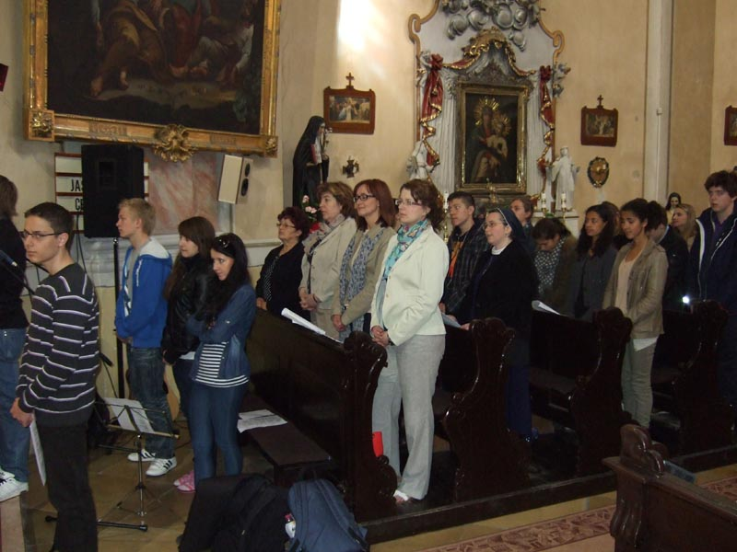
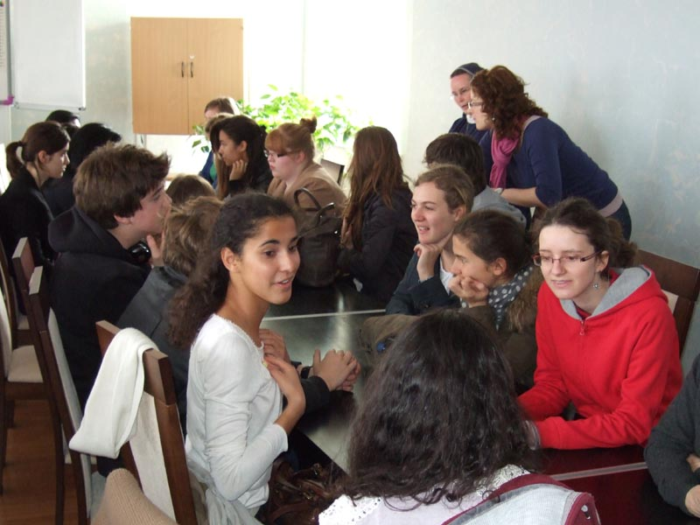
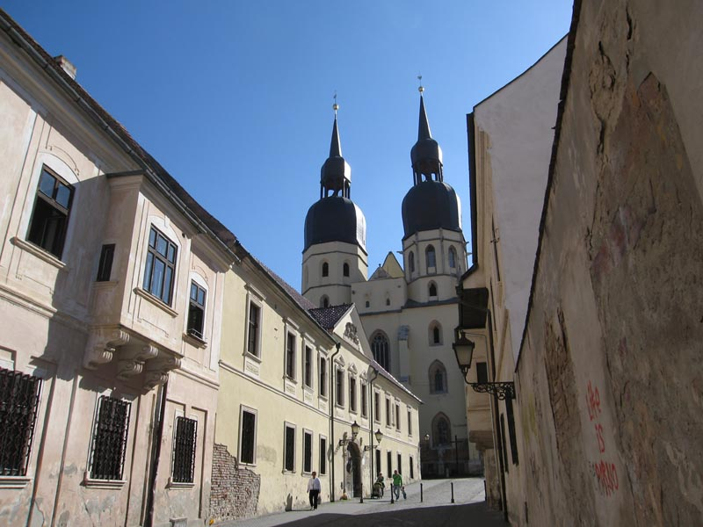
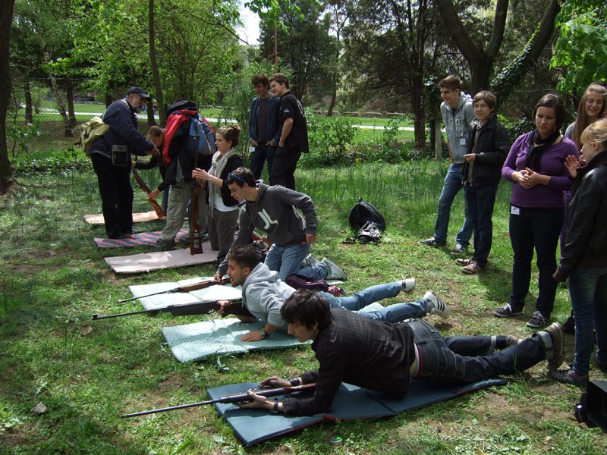

Slide 45
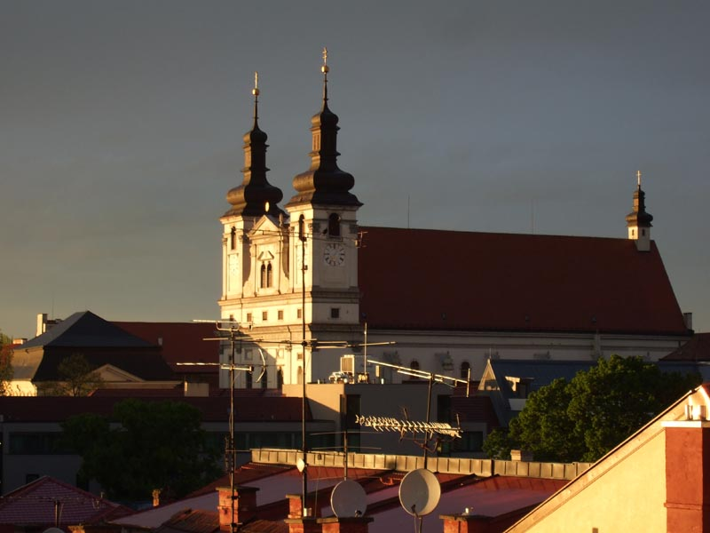
We cannot wait for the next collaborations that await us.

